Slide 1
Chapter 3: DIGITAL MARKETING ENVIRONMENT

Slide 2
Learning objectives
Identify and explore elements of an organisation’s marketing environment that have implications for developing a digital marketing strategy
Evaluate techniques for reviewing the importance of different players in the micro- environment: customers, competitors, suppliers, publishers, intermediaries and influencers, as part of the development of digital marketing strategy
Consider and evaluate the macro-environment factors affecting an organisation’s digital marketing strategy and implementation
Notes:
Identify and explore elements of an organisation’s marketing environment that have implications for developing a digital marketing strategy
* Evaluate techniques for reviewing the importance of different players in the micro- environment: customers, competitors, suppliers, publishers, intermediaries and influencers, as part of the development of digital marketing strategy
* Consider and evaluate the macro-environment factors affecting an organisation’s digital marketing strategy and implementation

Slide 3
Chapter content
Situation analysis for digital marketing
The digital marketing micro-environment
Customers analysis
Competitor analysis
Suppliers, publishers, intermediaries and influencers
Review changes to business and revenue models enabled by digital markets
The digital marketing macro-environment
Technological forces
Legal forces
Social, economic and political trends
Notes:
Introduction to online marketplace analysis
Situation analysis for digital marketing
The digital marketing micro-environment
Customers analysis
Competitor analysis
Suppliers, publishers, intermediaries and influencers
Review changes to business and revenue models enabled by digital markets
– New channel structures
– Digital business models
– Digital revenue models The digital marketing macro-environment
• Technological forces • Legal forces • Social, economic and political trends

Slide 4
Situation analysis for digital marketing
Customer journey: A description of modern multichannel buyer behaviour as customers use different media and touchpoints to achieve their goals, including selecting suppliers, making purchases and gaining customer support as part of the ‘path-to-purchase (Chaffey, 2019)
Online marketplace: Exchanges of information and commercial transactions between consumers, businesses and governments completed through different forms of online presence such as search engines, social networks, comparison sites and destination sites
Notes:
Customer journeys and the online marketplace
Customer journey
Khái niệm: là mô tả về hành vi mua sắm đa kênh của khách hàng khi họ sử dụng các phương tiện truyền thông và điểm chạm khác nhau để đạt được mục tiêu của mình, bao gồm việc lựa chọn nhà cung cấp, thực hiện mua hàng và nhận hỗ trợ từ nhà cung cấp như một phần của quá trình mua hàng (Chaffey, 2019)
A description of modern multichannel buyer behaviour as customers use different media and touchpoints to achieve their goals, including selecting suppliers, making purchases
and gaining customer support as part of the ‘path-to-purchase’.
Online marketplace
Exchanges of information and commercial transactions between consumers, businesses and governments completed through different forms of online presence such as search engines, social networks, comparison sites and destination sites.

Slide 5
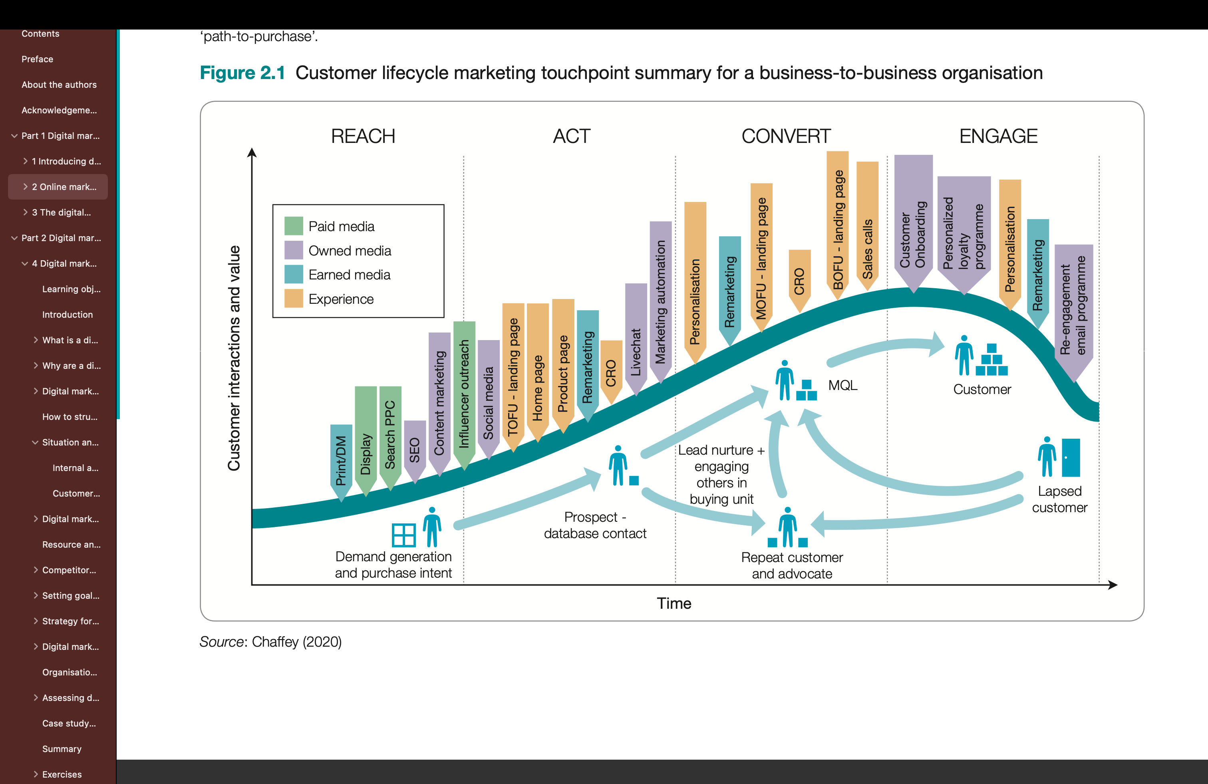
Customer journey
Figure: Customer lifecycle marketing touchpoint summary for a B2B organisation
Notes:
Figure 2.1 is intended to help businesses audit their use of digital communications as part of a ‘situation gap analysis’ where they can review whether they are using, or are investing sufficiently in, the most appropriate ‘always-on’ communications to achieve their goals across the RACE planning framework (introduced in Chapter 1). It highlights some of the many online marketing channels businesses can integrate to get the best results from digital marketing today. While some channels such as social media and SEO are well known, in our experience we find that some potential always-on marketing techniques such as ad and email retargeting and influencer outreach are used less widely.

Slide 6
Digital Marketing environment
Situation analysis: Collection and review of information about an organisation’s internal processes and resources and external marketplace factors in order to inform strategy definition.
Micro environment: The players (actors) and their interactions, which influence how an organisation responds in its marketplace.
Macro environment: Broad forces affecting all organisations in the marketplace, including social, technological, economic, political, legal and ecological influences.
Online market ecosystem: Interactions between different online systems related to a specific hardware or software technology, which may be independent or developed by a particular brand.
Notes:
Situation analysis
Collection and review of information about an organisation’s internal processes and resources and external marketplace factors in order to inform strategy definition.
Micro-environment
The players (actors) and their interactions, which influence how an organisation responds in its marketplace.
Macro-environment
Broad forces affecting all organisations in the marketplace, including social, technological, economic, political, legal and ecological influences.
Customer analysis. Digital marketing propositions and communications should be based around the customer – their characteristics, technology usage, behaviours, needs and wants.
B Marketplace analysis. Including intermediaries, influencers and potential partners. This involves identifying and reviewing the main online influences on purchase behav- iour. There are many influences to consider, including search engines, publisher media sites, blogs, review sites and social networks. Marketplace analysis also involves review- ing opportunities and threats from digital media and technology, including new busi- ness and revenue models.
C Competitor benchmarking. It is essential to understand how organisations compete in a particular marketplace; benchmarking customer propositions and communications activities against direct and indirect competitors and out-of-sector businesses can iden- tify opportunities for new approaches and digital marketing activities that need to be improved.
D Wider macro-environment. These are the broader strategic influences we cover in Chapter 3, including social, legal, environmental, political and technological influences.
E Internal review. Another major part of the situation involves an inward-looking internal review of the effectiveness of existing digital marketing approaches. This will include reviewing current results from digital marketing by review of key performance indica- tors (KPIs) and dashboards, and the organisational capabilities and processes used to manage digital marketing, summarised as strengths and weaknesses. We explain how to review performance by selecting relevant goals and KPIs in Chapter 4 (digital strategy) and Chapter 10 (digital analytics).
The major online players, sometimes known collectively as FAMGA (Facebook, Apple, Microsoft, Google and Amazon), have developed and continually evolve their own proprietary infra- structure or online market ecosystems or digital platforms that enable interactions with consumers via the 7Ds of digital marketing we introduced in Chapter 1, i.e. digital goals, digital audiences, digital devices, digital platforms, digital media, digital data and digital technology, giving opportunities to enhance the customer experience and extend the firms’ reach and influence. For example, Facebook uses APIs (i.e. Graph and Marketing) that enable companies to create audience profiles and run digital marketing campaigns via marketing technology services that use these APIs. The various functions of these APIs are to facilitate greater levels of automated interactions between Facebook users’ newsfeeds and profile pages. All the FAMGA companies have also been active in devel- oping digital mobile and smart home devices, which give new opportunities to market to audiences.

Slide 7
Strategic agility
Strategic agility: The capability to innovate and so gain competitive advantage within a marketplace by monitoring changes within an organisation’s marketplace, and then efficiently evaluating alternative strategies, selecting, reviewing and implementing appropriate candidate strategies.
Strategic agility involves:
collection, dissemination and evaluation of different information sources from the micro- and macro-environment;
developing processes for generating and reviewing the relevance of new strategies based on creating new value for customers;
research into potential customer value against the business value generated; implementation of prototypes of new functionality to deliver customer value;
measurement and review of results from prototypes to revise further to improve propositions or to end a trial.
Notes:
n the digital world, changes in market forces are increasingly rapid. Firms should respond to these changes, emerging opportunities and threats by developing strategic agility.
For the professional digital marketer, the most important task is to carry out a regular assessment of the forces that are shaping the online marketing environment and identify which forces have implications for their own marketing planning and strategic initiatives.
The forces listed have a different level of importance in influencing digital marketing activities. The main reason for keeping track of changes in the macro-environment is to be aware of how changes in social behaviour, new laws and technological innovation can create opportunities or threats. Organisations that monitor and respond effectively to their macro- environment can create differentiation and competitive advantages that enable the business to survive and prosper. So, in this chapter our attention is on those forces that have the greatest direct impact on digital marketing and for which practical knowledge is required when working in marketing.
Sự linh hoạt về mặt chiến lược
Khả năng đổi mới và nhờ đó đạt được lợi thế cạnh tranh trong thị trường bằng cách theo dõi những thay đổi trong thị trường của tổ chức và sau đó đánh giá hiệu quả các chiến lược thay thế, lựa chọn, xem xét và triển khai các chiến lược ứng viên phù hợp.

Slide 8
The digital micro-environment
Customer
Competitor
Suppliers, publishers, intermediaries and influencers
business and revenue models enabled by digital markets
Notes:
Review changes to business and revenue models enabled by digital markets

Slide 9
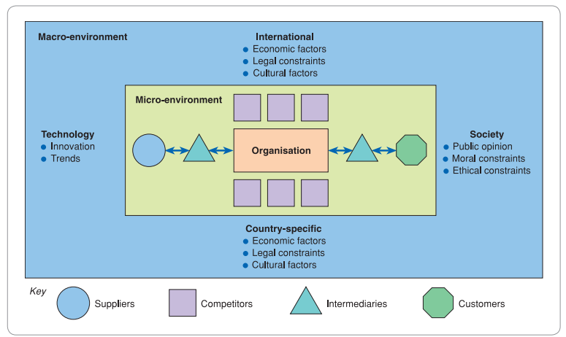
The digital marketing environment
Notes:
Online market ecosystem Interactions between different online systems related to a specific hardware or software technology, which may be independent or developed by a particular brand.
The major online players, sometimes known collectively as FAMGA (Facebook, Apple, Microsoft, Google and Amazon), have developed and continually evolve their own proprietary infra- structure or online market ecosystems or digital platforms that enable interactions with consumers via the 7Ds of digital marketing we introduced in Chapter 1, i.e. digital goals, digital audiences, digital devices, digital platforms, digital media, digital data and digital technology, giving opportunities to enhance the customer experience and extend the firms’ reach and influence. For example, Facebook uses APIs (i.e. Graph and Marketing) that enable companies to create audience profiles and run digital marketing campaigns via marketing technology services that use these APIs. The various functions of these APIs are to facilitate greater levels of automated interactions between Facebook users’ newsfeeds and profile pages. All the FAMGA companies have also been active in devel- oping digital mobile and smart home devices, which give new opportunities to market to audiences.

Slide 10
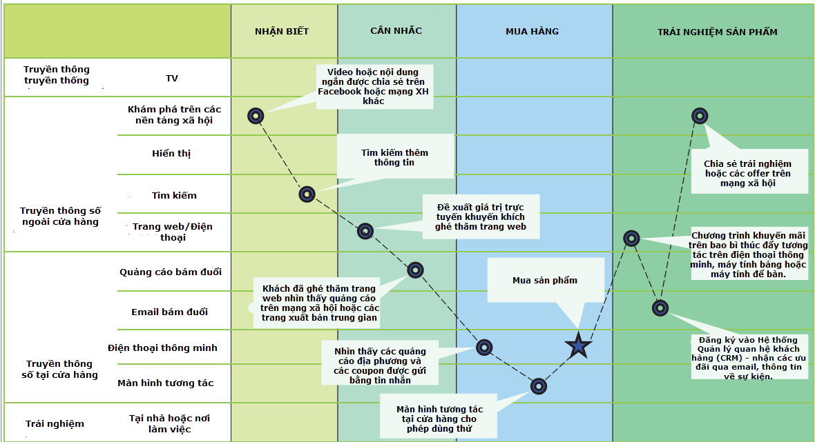
Customer analysis
To help understand customers’ interactions with physical and digital touchpoints, triggers and influences, journey maps can be used to summarise the behaviour of different types of target audiences.
Figure: Customer journey map
Notes:
To help understand customers’ interactions with physical and digital touchpoints, triggers and influences, journey maps can be used to summarise the behaviour of different types of target audiences.

Slide 11
Online marketplace map
Online marketplace map: summarises how target customer segments might be influenced by different types of digital sites.
The main elements of the online marketplace map:
Customer segments
Search intermediaries
Intermediaries, influencers and media or publisher sites
Destination sites and platforms
Notes:
To help understand the influences on online customer journeys it is useful to produce an online marketplace map, as shown in Figure 2.4, which summarises how target customer segments might be influenced by different types of digital sites. The main elements of the online marketplace map are:

Slide 12
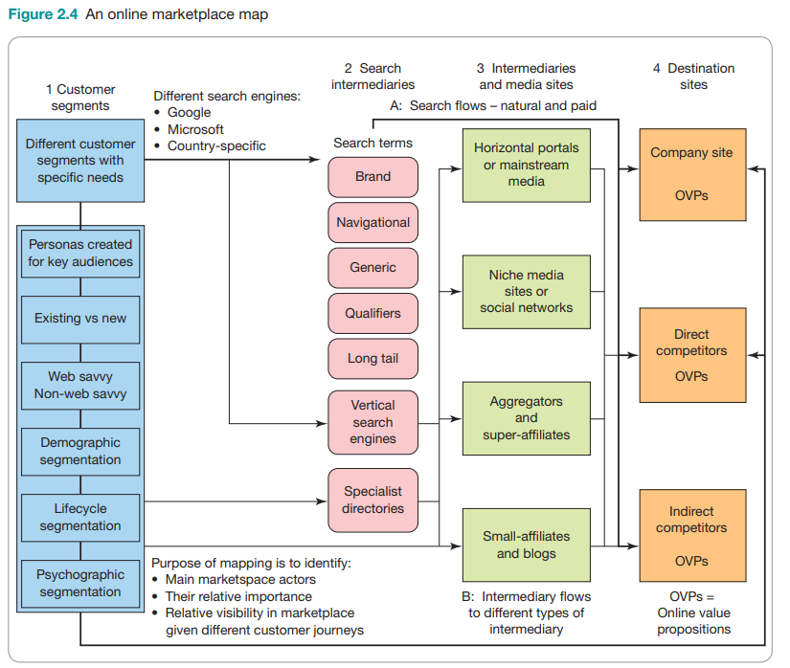
Figure: Online marketplace map
Notes:
Brand terms include brands and sub-brands’ names, e.g. ‘L’Oréal Paris’, ‘Garnier’ or Maybelline New York’.
Navigational terms for Brand + 6Product7, e.g. ‘Garnier skin care’ or ‘Garnier body care’.
Generic search terms’ visibility, e.g. ‘skin care’ or ‘body care’.
Specific ’long tail’ terms of four or more keywords, e.g ‘beauty day cream for dry skin’.
Qualifier terms added to describe consumer needs, such as ‘best’, ‘cheap, ‘new’ or ‘reviews’.

Slide 13
Concepts in online marketplace map
Share of search
An evaluation of the proportion of website visits from organic and paid search that a brand attracts for a defined set of target search terms used by an audience searching for a market category of product, service or other information.
A search gap analysis can be performed to assess potential visits from consumer search intent against actual visits achieved through SEO and pay-per-click activities
Aggregators
An alternative term to price-comparison sites. Aggregators include product, price and service information, comparing competitors within a sector such as financial services, retail or travel. Their revenue models commonly include affiliate revenues (CPA), pay-per- click advertising (PPC) and display advertising (CPM).
Notes:
Share of search
Đánh giá về tỷ lệ lượt truy cập trang web từ tìm kiếm không phải trả tiền và tìm kiếm có trả tiền mà một thương hiệu có được từ một tập hợp cụm từ tìm kiếm mục tiêu xác định được khán giả (audience) sử dụng khi tìm kiếm danh mục sản phẩm, dịch vụ hoặc thông tin khác trên thị trường.
Có thể thực hiện phân tích tương quan tìm kiếm để đánh giá số lượng lượt truy cập tiềm năng từ ý định tìm kiếm của người tiêu dùng so với các lượt truy cập thực tế đạt được thông qua hoạt động SEO và trả tiền cho mỗi lần nhấp chuột.
Aggregators
An alternative term to price-comparison sites. Aggregators include product, price and service information, comparing competitors within a sector such as financial services, retail or travel. Their revenue models commonly include affiliate revenues (CPA), pay-per- click advertising (PPC) and display advertising (CPM).

Slide 14
Concepts in online marketplace map
Affiliates
Companies promoting a merchant, typically through a commission- based arrangement either direct or through an affiliate network.
Key online influencers
Celebrities, individuals well known in their niche, or publishers to whom an online target audience listens and interacts with. Online influencer outreach or ‘blogger outreach’ can help companies reach and engage a wider audience. Recently, video bloggers (‘vloggers’ or ‘YouTubers’) have become popular among teenage audiences.
Notes:
Share of search
An evaluation of the proportion of website visits from organic and paid search that a brand attracts for a defined set of target search terms used by an audience searching for a market category of product, service or other information. A search gap analysis can be performed to assess potential visits from consumer search intent against actual visits achieved through SEO and pay-per-click activities.
Aggregators
An alternative term to price-comparison sites. Aggregators include product, price and service information, comparing competitors within a sector such as financial services, retail or travel. Their revenue models commonly include affiliate revenues (CPA), pay-per- click advertising (PPC) and display advertising (CPM).
Affiliates
Companies promoting a merchant, typically through a commission- based arrangement either direct or through an affiliate network.
Key online influencers
Celebrities, individuals well known in their niche, or publishers to whom an online target audience listens and interacts with. Online influencer outreach or ‘blogger outreach’ can help companies reach and engage a wider audience. Recently, video bloggers (‘vloggers’ or ‘YouTubers’) have become popular among teenage audiences.
Mainstream news media sites or portals. These include traditional (for example, • FT.com, The Times, Guardian) or pureplay (such as Google News).
Niche/vertical media sites. For example, EconsultancyTM, Smart InsightsTM and Mar- • keting LandTM are in a business-to-business niche covering digital marketing.
• •
Social networks and digital platforms. For example, Facebook, YouTube, Instagram, Twitter, WhatsApp, WeChat, LinkedIn. Price comparison sites (also known as aggregators). For example, Google ShoppingTM, PriceGrabberTM, GoCompareTM, Shopping.comTM, Confused.comTM and MoneySuperMarketTM.
Super-affiliates. Affiliates gain revenue from a merchant they refer traffic to by being paid commission based on a proportion of the sale or a fixed amount. At one point they were important in transactional e-commerce markets, accounting for tens of per
• cent of sales. Niche affiliates or bloggers. These are often individuals, but they may be very influ- ential. For example, in the United Kingdom, Martin Lewis of MoneySavingExpert.com receives millions of visits every month. Smaller affiliates and bloggers can be impor- tant collectively. With the growth in readership and social interactions on blogs, iden- tifying key online influencers within a market is important to help reach and engage target audiences (as illustrated by Mini case study 2.1).

Slide 15
Customer analysis
Customer behaviour analysis
In digital markets, this type of analysis involves research into the motivations, media consumption preferences and selection processes used by consumers as they use digital channels together with traditional channels to purchase online products and use other online services.
Customer insight
Knowledge about customers’ needs, profile, preferences and digital experiences from analysis of qualitative and quantitative data. Specific insights can be used to inform marketing tactics directed at groups of customers with shared characteristics.
Notes:
Customer behaviour analysis In digital markets, this type of analysis involves research into the motivations, media consumption preferences and selection processes used by consumers as they use digital channels together with traditional channels to purchase online products and use other online services.
Customer insight
Knowledge about customers’ needs, profile, preferences and digital experiences from analysis of qualitative and quantitative data. Specific insights can be used to inform marketing tactics directed at groups of customers with shared characteristics.

Slide 16
Customer analysis
Customer behaviour analysis: can be considered from 2 perspectives
Demand and gap analysis: the potential online reach against impressions, volume of visitors to an online presence and the extent to which prospects convert to tactical and strategic outcomes, e.g. lead generation and sales.
Digital consumer behaviour: the needs, characteristics and digital experiences or behaviours of target consumers.
Customer characteristic analysis:
Includes: demographic, psychological and behavioral characteristics
Customer personas
The buying process
Notes:
Digital consumer behaviour. Here a marketer wants to understand the needs, characteris- tics and digital experiences or behaviours of target consumers. These variables are often collectively referred to as customer insight. Based on this analysis, customer segments can be created that will be used to develop targeting approaches as part of strategy and planning (described in Chapter 4 onwards).
Demographic variables. Any personal attributes that tend to remain static throughout an individual’s lifetime, or evolve slowly over time – such as age, gender, race, etc. – can be defined as demographic variables. Key elements of a consumer’s demographic profile that have been found to influence online behaviour include variables such as: income, education, race, age (Hoffman et al., 2000; Sebastianelli et al., 2008); gender (van Slyke et al., 2002); lifestyle (Brengman et al., 2005); and cultural and social make-up (Shiu and Dawson, 2004). Research has identified gender differences affecting online purchasing behaviour, with differences shaping attitudes towards pricing and shopping experiences (Ryu, 2020).
2 Psychographic and behavioural variables. Any aspect of a consumer’s perceptions, beliefs and attitudes that might influence online behaviour, and in particular a consumer’s inten- tion to buy a product or service, can be defined as a psychographic/behavioural variable. Indeed, there has now been a significant amount of work to explore how the consumer’s character or personality might influence their online behaviour (George, 2004; Mendes et al., 2020; Parsad et al., 2019). Researchers have explored how a wide range of person- ality traits and behavioural characteristics, such as knowledge, attitude, innovativeness and risk aversion, could have a significant effect on predicting a consumer’s intention to shop online and the types of goods they might purchase (Cheung et al., 2005; Piroth et al., 2020). Language, social interactions and online friendships have become increas- ingly important influencing factors with the growth of social media (Kizgin et al., 2020). At a practical level, interest-based targeting advertising options are available that enable businesses to go beyond conventional demographic ad targeting, as explored in Mini case study 2.3.

Slide 17
Customer analysis
Demand analysis:
Quantitative determination of the potential use and business value from online customers of an organisation. Qualitative analysis of perceptions of online channels is also assessed.
To assess the volume and share of customers who:
are ‘in market’ for a service, i.e. they have intent to use it;
have access to the digital channel;
use specific online services that may affect the purchase decision, such as price comparison sites, social networks and specialist blogs;
are influenced by using the digital channel but purchase using another channel as part of the multichannel buyer behaviour;
purchase or use other services using the digital channel.
Notes:
Quantitative determination of the potential use and business value from online customers of an organisation. Qualitative analysis of perceptions of online channels is also assessed.
the digital marketer also needs to assess the volume and share of customers who:
- are ‘in market’ for a service, i.e. they have intent to use it;
- have access to the digital channel;
- use specific online services that may affect the purchase decision, such as price comparison sites, social networks and specialist blogs;
- are influenced by using the digital channel but purchase using another channel as part of the multichannel buyer behaviour;
- purchase or use other services using the digital channel.

Slide 18
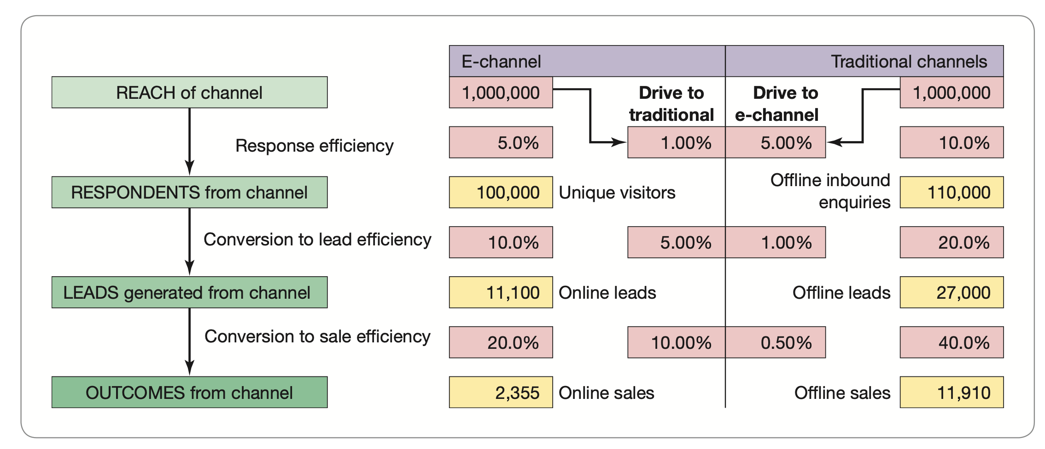
Customer analysis
Conversion marketing: Using marketing communications to maximise conversion of potential customers to actual customers.
Model showing conversion between the digital channel and traditional channels during the buying process
Notes:
Conversion marketing
Using marketing communications to maximise conversion of potential customers to actual customers.

Slide 19
Customer analysis
Digital consumer behaviour:
Customer choice and digital influence: the web and social media are
a vital part of the research process, as internet users now spend longer researching products online;
used at every stage of the research process from the initial scan to the more detailed comparison and final checking of specifications before purchase.
ZMOT model

Slide 20
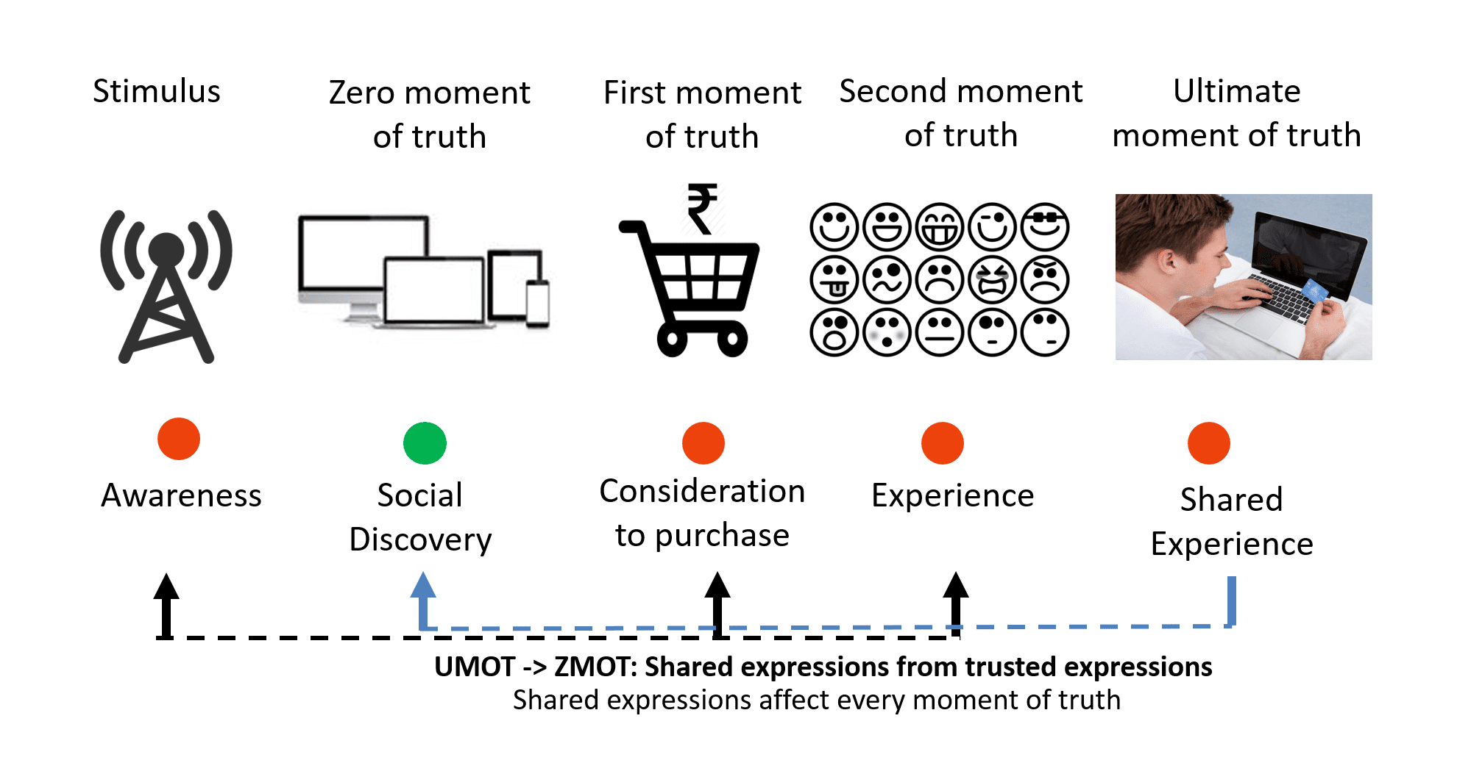

Slide 21
Customer analysis
Customer characteristics:
Demographic characteristics
Psychological and behavioral characteristics
Concepts that can positively or negatively influence or motivate the consumer to engage with a digital offer:
Information processing (IP).
Perceived ease of use.
Perceived usefulness
Perceived benefits
Perceived control
Skills
Trust and risk
Enjoyment
Notes:
1. Information processing (IP). This is very important as it shapes how a consumer deals with available data and information that will shape their future behaviour. IP involves the mental processes and senses an individual uses to interpret the world they inhabit (Wang and Benbasat, 2013).
2 Perceived ease of use. This also needs consideration by digital marketers, as the easier a website or mobile site is to use, the more likely a customer will have a positive online experience (Cheung et al., 2005). Customers can also benefit from lower search costs and the efficacy of buying at any time from the comfort of their home or office.
3 Perceived usefulness. This refers to the extent to which the digital offer fits with the cus- tomer’s daily life – for instance, shopping, booking train tickets online, banking (Arnold et al., 2005). It is here that the digital marketer can really start to develop a path to con- sumer benefits.
4 Perceived benefits. If a customer feels they will be rewarded in some positive way by engaging with a digital offer, this is likely to generate support for an online brand (Arnold et al., 2005).
5 Perceived control. If a customer is a skilled user of the digital technology in question, then they will feel they are able to function successfully in this environment. Earlier in the chapter we discussed how some mobile shoppers are confident whereas others are not.
6 Skill. This refers to the customer’s ability to use the technology to achieve their desired goals (Klein and Ford, 2002). It has been found that individuals learn by doing in the internet environment and so build their skill set over time – for example, the more frequent the visitor is to a website the greater their exposure and the higher their ability
to engage with this digital content.
7 Trust and risk. Both play an important role in how a customer behaves online. Inexperienced internet users can feel vulnerable and fear the unknown. Customers should be able to achieve their buying goals with or without feeling they are exposed to undue risk (e.g. financial risk, social risk, personal risk). Marketers should seek to find ways to limit the risk of engaging with their online offer and seek to build trust through developing online relationships (Vize et al., 2013) and enabling customers to feel they are purchasing in a safe and secure online environment (Nepomuceno et al., 2013).
8 Enjoyment. This is an outcome of a positive online experience and leads to perceptions of greater overall customer satisfaction.

Slide 22
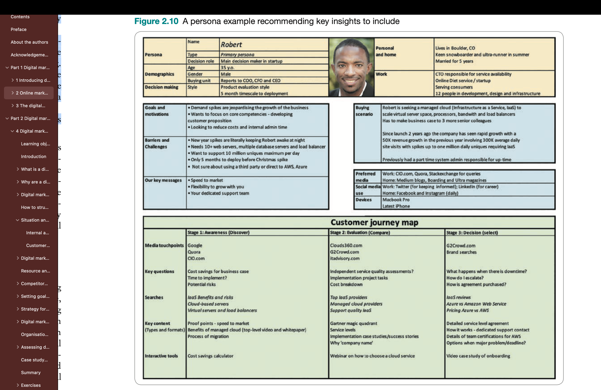
Customer analysis
Persona:
Fictional profiles that represent a particular target audience – a thumbnail summary of the characteristics, needs, motivations and environment of typical website users.(Chaffey, 2022)

Slide 23
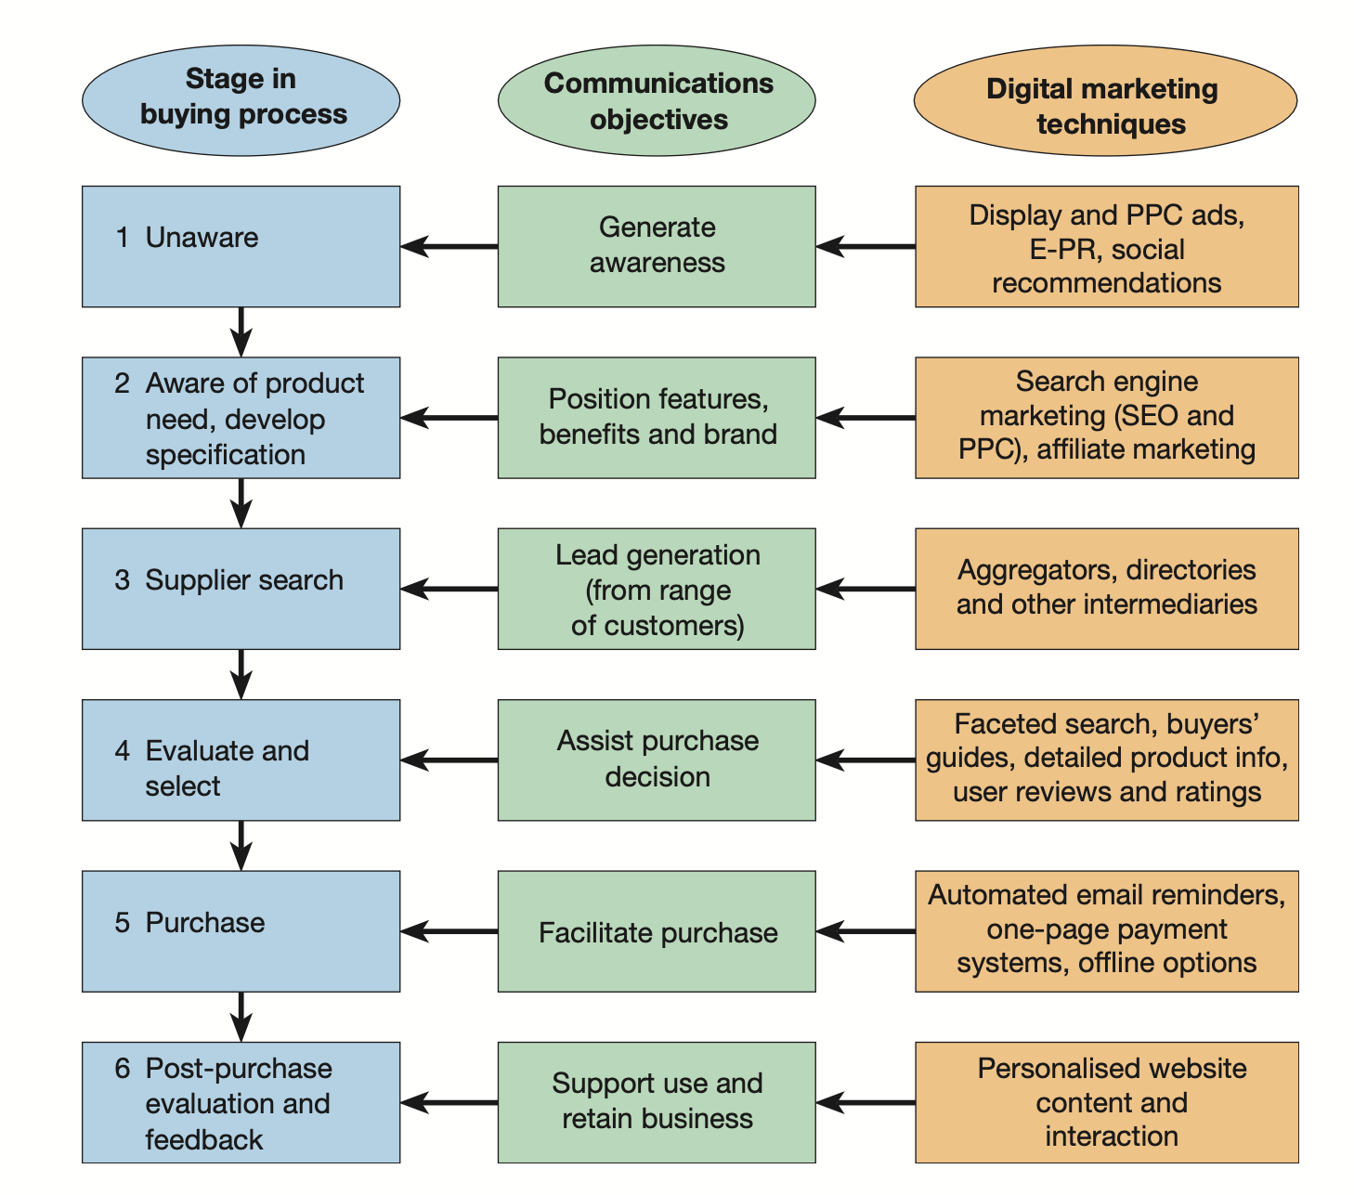
Customer analysis
The buying process
A summary of how digital media can impact on the buying process for a new purchaser
Notes:
Customer characteristics are important to understand in relation to the buying process. According to Kotler et al. (2020), there are different stages in the buying process. At each stage the purpose (from both the buyer and supplier perspective) is a particular outcome:
• awareness; • interest; • evaluation; • trial;
• adoption. This set of outcomes has been considered in the digital market and Chaffey and Smith (2017)
describe them as:
1 problem recognition;
2 information search;
3 evaluation;
4 decision;
5 action (sale or use of online service);
6 post purchase.
Figure 2.11 gives a summary of how digital channels can be used to support the different stages in the buying process. Note that social media can potentially support each stage as consumers ask others via social networks for recommendations, or read reviews and ratings. The boxes on the left show the typical stages that a new prospect passes through

Slide 24
Competitor analysis
The shape and nature of online competitive markets
bargaining power of buyers;
bargaining power of suppliers;
threat of substitute products and services;
threat of new entrants;
intensity of rivalry.
Competitor analysis and Benchmarking techniques
A structured analysis of the online services, capabilities and performance of an organisation within the areas of customer acquisition, conversion, retention and growth.
Notes:
The nature of the rivalry between the companies trading online is largely determined by the number of players in a market and their relative sizes, the structure of costs and pric- ing, the switching costs customers will encounter if they change, strategic objectives and exit barriers. The flexibility and scope for smart digital products creates opportunities for firms to differentiate from the competition and to offer a greater range of value-added services, which heats up the intensity of the rivalry. Smart-connected products often span traditional product boundaries and firms can find themselves competing in completely new markets. For example, the Home Connect AppTM links household appliances, heating, lighting and other devices together. Amazon Alexa, Telsa, Nest, IFTTT, myTaste and Drop are all part- ners in the Home Connect ecosystem and they are all competing to be a chosen solution provider in the connected home.
By using the five forces model for analysing the structure and nature of the competition, digital marketers can gain insights into how firms compete in a particular marketplace. According to Porter and Heppelmann (2014), the competitive boundaries are expanding to encompass sets of related products and, as a consequence, the ‘basis of competition thus shifts from the functionality of a discrete product to the performance of a broader product system’. But these authors also remind us that it is important not to lose sight of the end user – for example, adding functionality that buyers don’t want to pay for doesn’t add value.
The next sub-section explores how to analyse competitors and assess their potential.

Slide 25
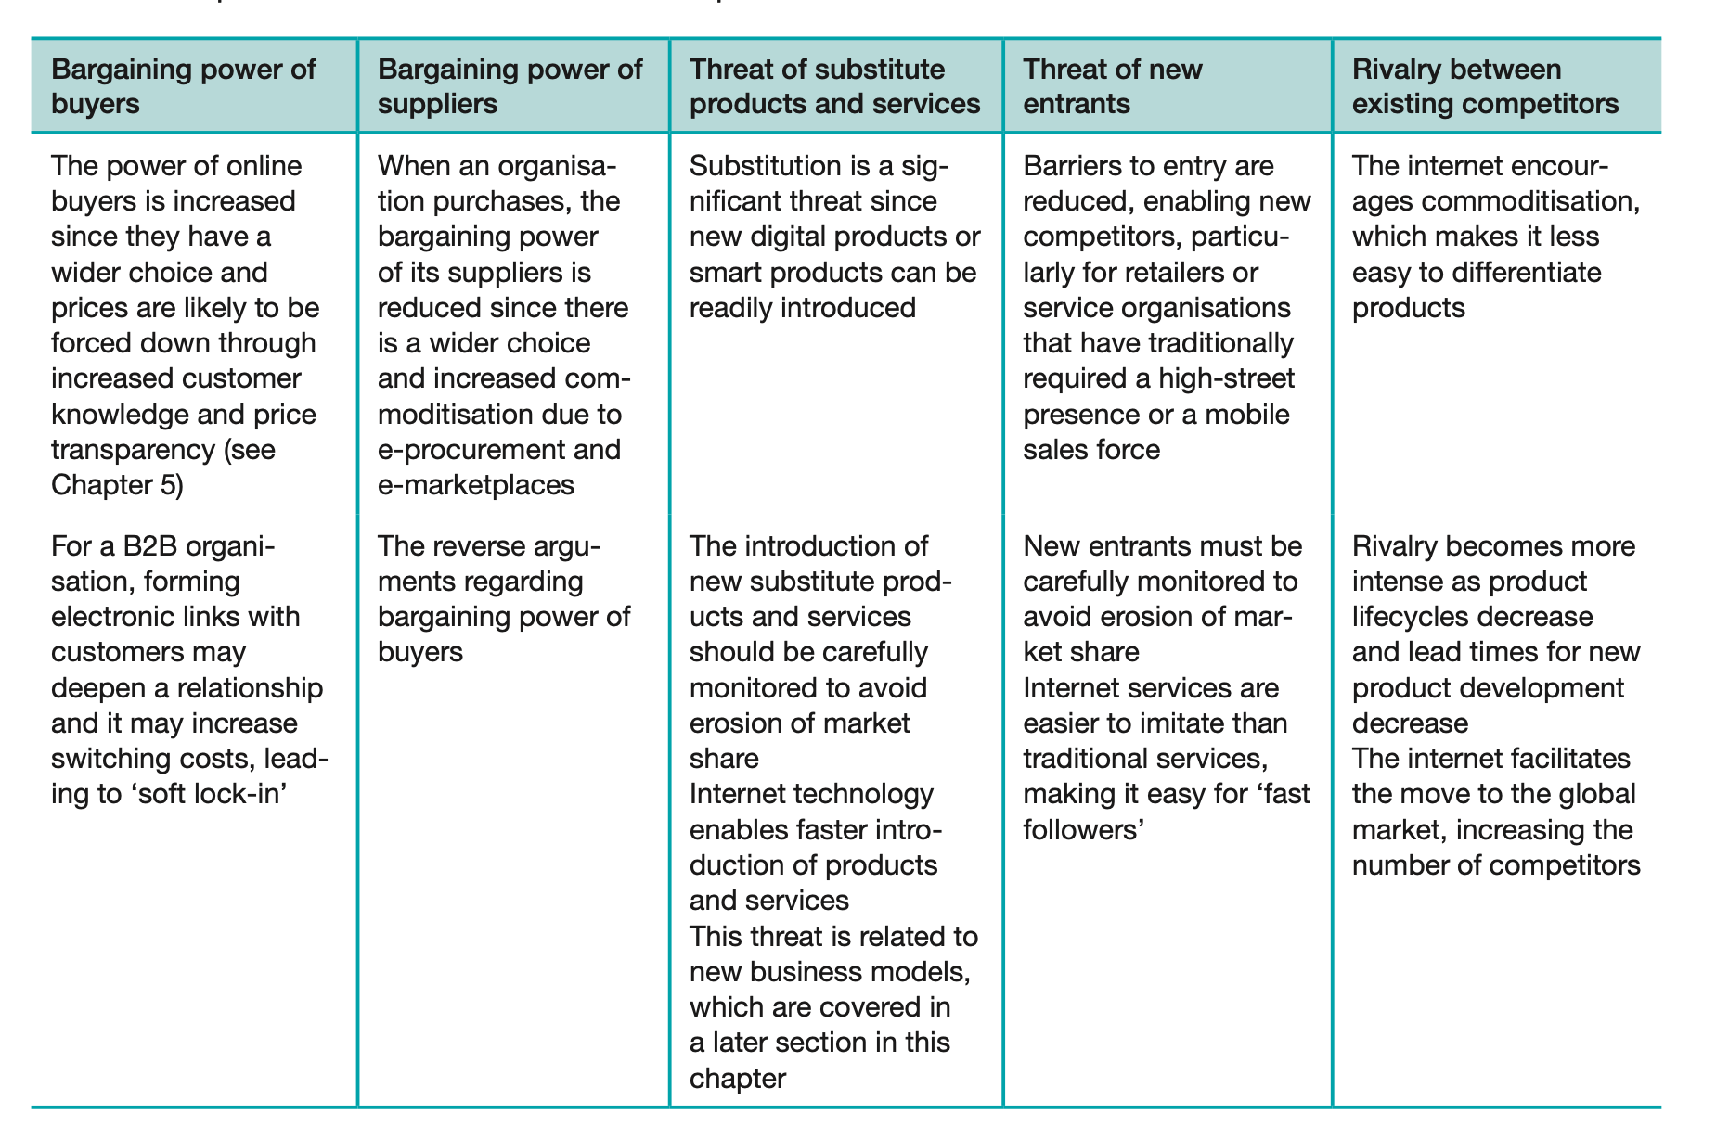
Competitor analysis
Impact of the internet on the five competitive forces

Slide 26
Competitor analysis (cont.)
Competitor Benchmarking:
Based on a systematic comparison, with specific criteria (KPI/metrics) of digital marketing approaches of competitors in the market.
Implemented continuously and regularly
Helps assess threats from products/services that competitorss are providing, identifying opportunities for businesses to improve their own digital services
Do not evaluate based on whether or not a criterion/feature is present, but based on accessibility or usefulness (with a specific scale).
Notes:
Dựa trên việc so sánh có hệ thống, với các tiêu chí cụ thể (KPI/metrics) cách tiếp cận digital marketing của các ĐTCT trên thị trường.
Diễn ra liên tục, thường xuyên
Giúp đánh giá được mối đe dọa từ các sản phẩm/dịch vụ mà các ĐTCT đang cung cấp, xác định các cơ hội để doanh nghiệp có thể tự cải thiện các dịch vụ digital của mình
Không đánh giá dựa trên việc có hay không một tiêu chí/hay một tính năng gì mà phải dựa trên khả năng tiếp cận hay mức độ hữu ích (có thang đo mức độ cụ thể)

Slide 27
Competitor analysis (cont.)
Benchmarking: Different perspectives serving different purposes:
1. Internal capabilities: such as resourcing, structure, and processes vs external customer-facing features of the sites.
2 Different aspects of the customer lifecycle: customer acquisition, and conversion to retention.
e.g. reviewing their presence in the paid and natural listings of the search engines
3 Qualitative to quantitative: from qualitative assessments by customers through surveys and focus groups through to quantitative analysis by independent auditors of data across customer acquisition
e.g. number of site visitors or reach within market, cost of acquisition, number of customers, sales volumes and revenues and market share); conversion and retention such as repeat conversion and number of active customers.
4 In-sector and out-of-sector: benchmarking against similar sites within sector and reviewing out-of-sector to sectors such as online publishers, social networks, and brand sites.
e.g: the expert evaluation: the suitability of the site for different audiences; measures under the overall construction (usability and accessibility), message (which covers key brand messages and suitability for international audiences) and contact’
5 Financial to non-financial measures: reviewing competitive intelligence sources such as company reports or tax submissions, turnover and profit generated by digital channels; the company’s capability including resourcing, innovation and learning.
6 From user experience to expert evaluation.
Notes:
customer acquisition, conversion to retention. Capabilities are benchmarked in each of the activities shown in Table P.1 in the Preface.
For example, what are the capabilities of a competitor within search marketing through
reviewing their presence in the paid and natural listings of the search engines?
3 Qualitative to quantitative: from qualitative assessments by customers through surveys and focus groups to quantitative analysis by independent auditors of customer acquisi- tion such as those featured in Tables 2.1 and 2.3. Examples of KPIs include number of site visitors or reach within market, cost of acquisition, number of customers, sales volumes and revenues and market share; conversion (average conversion rates) and retention such
as repeat conversion and number of active customers.
4 In-sector and out-of-sector: benchmarking against similar sites within sector and review-
ing out of sector in sectors that tend to be more advanced, e.g. online publishers, social networks and brand sites. Benchmarking services are available for this type of compari- son from analysts such as Bowen Craggs Index (www.bowencraggs.com). An example of one of their benchmark reports is shown in Figure 2.13. You can see that this is based on the expert evaluation of the suitability of the site for different audiences as well as measures under the overall construction (which includes usability and accessibility), mes- sage (which covers key brand messages and suitability for international audiences) and contact (which shows integration between different audiences).
5 Financial to non-financial measures: through reviewing competitive intelligence sources such as company reports or tax submissions, additional information may be available on turnover and profit generated by digital channels. But other forward-looking aspects of the company’s capability that are incorporated on the balanced scorecard framework (see Chapter 4) should also be considered, including resourcing, innovation and learning.
6 From user experience to expert evaluation: benchmarking research should take two alter- native perspectives, from actual customer reviews of content and usability to expert evaluations.

Slide 28
Competitor benchmarking elements to review across the RACE planning framework
RACE goal | Marketing activities and communications to review | Tools and techniques to support benchmarking
Reach – grow your audience using paid, owned and digital media | Website – compare reach of website including unique visitors by digital channel Organic search marketing – keyword visibility, number of backlinks, site speed Paid search marketing – number of keywords targeted, average positions and cost-per-click Organic social media – content strategy of pages used to drive reach Digital advertising – using programmatic and paid social media – types of ads used Digital intermediaries – depending on sectors these may include comparison sites, aggregators, influencers and co-marketing (B2B) | . Website audience intelligence tools such as similarweb.com and alexa.com 2. Search marketing tools such as SEMRush. com and Ahrefs.com showing ranking for target keywords. Google site speed tools 3. Google Ads impression share measure and competitive analysis from Spyfu.com and SEMRush.com 4. Direct comparison of followers or using tools such as Socialbakers.com and Falcon.io 5. Adbeat.com and WhatRunsWhere.com. Ad retargeting to support other parts of RACE can also be reviewed after sites have been visited 6. Manual review of intermediaries appearing in search results for defined customer keywords

Slide 29
Competitor benchmarking elements to review across the RACE planning framework (cont.)
RACE goal | Marketing activities and communications to review | Tools and techniques to support benchmarking
Act – prompt interactions to encourage subscribers and leads | Customer journeys – what are the main outcomes the site or app is looking to achieve? Explaining brand value proposition – how is the offer explained, how is it differentiated? Audiences targeted and profiling – assess call-to-action and content appealing to specific audiences Lead generation – what are lead magnets, i.e. offers or content used to encourage people to subscribe? Content strategy – how is content used to support consumer decision-making on the path to purchase? | A manual assessment of navigation and home page calls-to-action A manual review of key messages, tone of voice and validation on home page, landing pages and conversion pages A manual review of direct appeals to audiences and profiling through fields on forms Assess lead magnets on home page and how they differ for services in different sections of site Includes top-of-funnel for lead generation, but also middle-, bottom-of-funnel content, blog, resource centres and branded content

Slide 30
Competitor benchmarking elements to review across the RACE planning framework (cont.)
RACE goal | Marketing activities and communications to review | Tools and techniques to support benchmarking
Convert – achieve sales online or offline | Email communications – contact strategy for welcome and nurture emails Pricing and promotions – comparing pricing and discounts for selected products Distribution options – options for delivery where relevant Conversion rate optimisation – changes to key pages can be monitored Assisted selling – review use of LiveChat and conversational marketing tools | 1. Benchmarkemail.com for creative comparison and ReturnPath (from Validity) for deliverability 2. Paid services such as Pricezag.com and Minderest.com 3. For example, delivery fees and click-and-collect 4. Page monitoring using wachete.com or Changetower.com. Use of CRO tools and other martech can be assessed using Builtwith.com or Similartech.com 5. Tools such as Intercom.com

Slide 31
Competitor benchmarking elements to review across the RACE planning framework (cont.)
RACE goal | Marketing activities and communications to review | Tools and techniques to support benchmarking
Engage – encourage repeat business and advocacy | Customer onboarding – how are new customers welcomed? Customer loyalty – are loyalty schemes used? Customer service and community – how is customer service delivered? Customer email communications – including targeted offers and customer newsletter Ad retargeting – also relevant for Act and Convert | Manual review requiring mystery shopping Manual review including different level Manual review of community or forum options, including social media 4. Benchmarkemail.com for creative comparison and ReturnPath for deliverability 5. Manual review of ads or using Adbeat.com and WhatRunsWhere.com

Slide 32
Publishers, intermediaries and influencers
Publisher: online publishers or media sites can provide dif- ferent services for a business to reach target audiences using the paid, owned and earned media::
Paid media: many publishers belong to ad networks where they sell their ad inventory for programmatic display advertising or via the Google Display Network and Facebook • Audience Network, where they can be targeted based on content viewed or their profile.
Owned media: publishers will also have their own social media platforms, which may give additional opportunities to reach target audiences.
Earned media: opportunities to publish native advertising, guides or guest blogs may also be available.
Notes:
Online publishers or media sites can provide different services for a business to reach target audiences using the paid, owned and earned media:
Paid media: many publishers belong to ad networks where they sell their ad inventory for programmatic display advertising or via the Google Display Network and Facebook, Audience Network, where they can be targeted based on content viewed or their profile.
Owned media: publishers will also have their own social media platforms, which may give additional opportunities to reach target audiences. Earned media: opportunities to publish native advertising, guides or guest blogs may also be available.

Slide 33
Publishers, intermediaries and influencers (cont.)
Intermediaries:
Firms that can help a company to promote, sell and distribute its products or services, for example publisher or media sites, comparison sites, search engines, social networks and blogs.
Electronic intermediaries sites: Online stores, Auction sites, E-commerce sites (Amazon, shoppee, lazada, tiki…)
Digital marketing intermediaries:
Online market research
Infomediaries
Portals, search engines
Digital marketing/ online advertising agencies
Electronic financial intermediaries: banks, e-payment service providers
Other players
Forums, blogs, groups, social communities, influencers
Review and comparison sites (aggregators)
Other public groups

Slide 34
New channel structures
Channel structure: The configuration of partners in a distribution channel.
Disintermediation: The removal of intermediaries such as distributors or brokers that formerly linked a company to its customers.
Reintermediation: The creation of new intermediaries between customers and suppliers providing services such as supplier search and product evaluation.
Notes:
Channel structure
The configuration of partners in a distribution channel.
Disintermediation
The removal of intermediaries such as distributors or brokers that formerly linked a company to its customers.
Reintermediation
The creation of new intermediaries between customers and suppliers providing services such as supplier search and product evaluation.

Slide 35
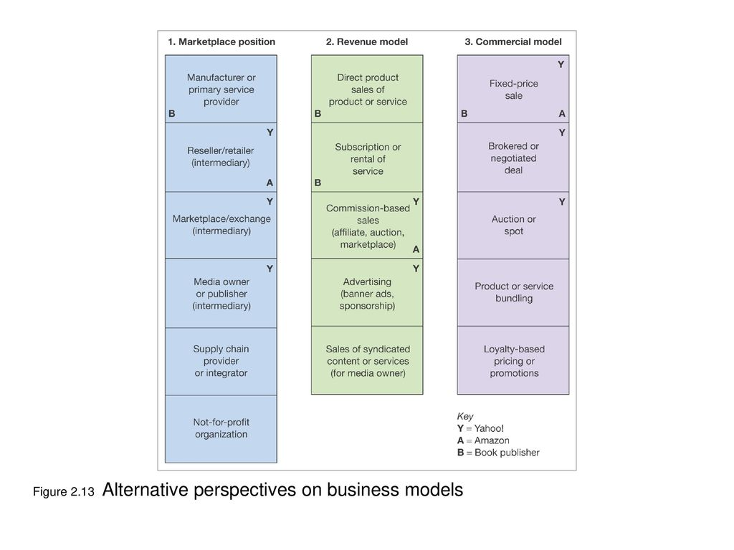
Digital business model
Three perspectives in developing strategic digital business
Notes:
A summary of how a company will generate a profit – identifying its core product or service value proposition, target customers in different markets, position in the competitive online marketplace or value chain and its projections for revenue and costs.

Slide 36
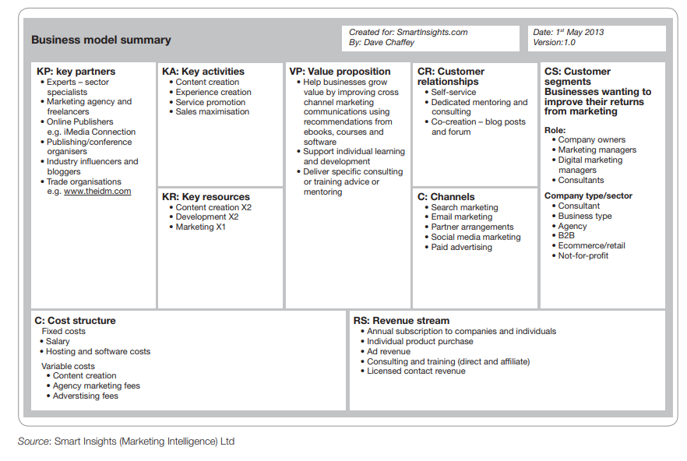
Digital business model (cont.)
A summary of how a company will generate a profit – identifying its core product or service value proposition, target customers in different markets, position in the competitive online marketplace or value chain and its projections for revenue and costs.
Notes:
A summary of how a company will generate a profit – identifying its core product or service value proposition, target customers in different markets, position in the competitive online marketplace or value chain and its projections for revenue and costs.

Slide 37
Digital business model (cont.)
Revenues from selling products
Main online revenue models:
CPM display advertising on site: ‘cost per thousand’ (‘mille’)
CPC advertising on site (pay-per-click text ads)
Sponsorship of site sections or content types (typically fixed fee for a period)
Affiliate revenue (CPA, CPC…)
Transaction fee revenue
Subscription access to content or services
Pay-per-view access to documents
Subscriber data access for email marketing
Notes:
CPM display advertising on site: ‘cost per thousand’ (‘mille’)
CPC advertising on site (pay-per-click text ads)
Sponsorship of site sections or content types (typically fixed fee for a period)
Affiliate revenue (CPA, CPC…)
Transaction fee revenue
Subscription access to content or services
Pay-per-view access to documents
Subscriber data access for email marketing

Slide 38
Digital business model (cont.)
Forecasting revenue for an online business
Number and size of ad units.
Capacity to sell advertising.
Fee levels negotiated for different advertising models.
Capacity to sell advertising.
Traffic volumes.
Visitor engagement.
Notes:
Forecasting revenue for an online business
Number and size of ad units. This is a delicate balance between the number of ad units in each site section or page – too many obtrusive ad units may present a bad experience for site users, too few will reduce revenue. Figure 2.17 has a parameter for the number of ad units or containers in each ad revenue category. There is a tension with advertisers who know that the awareness and response they generate from their ads is maximised when they are as large as practical and in prominent placements. A more accurate revenue model would develop revenue for different page types such as the home page and different
page categories, e.g. the money or travel sections. Capacity to sell advertising. Figure 2.17 also has a parameter for the percentage of ad inventory sold in each category – for example, for the CPM ad display revenue only 40 per cent of inventory may be sold. This is why you may see publisher sites with their own ‘house ads’ – it is a sign they have been unable to sell all their ad space. A benefit of
using the Google AdSense publisher programme is that inventory is commonly all used. Fee levels negotiated for different advertising models. These will depend on the mar- ket competition or demand for advertising space. For ‘pay-per-performance’ advertising options such as the CPC and CPA models, it also depends on the response. In the first case, the site owner receives revenue only when the ad is clicked upon and in the second case, the site owner receives revenue only when the ad is clicked upon and a product is
purchased on the destination merchant site. Traffic volumes. More visitors equate to more opportunities to generate revenue through serving more pages (which helps with CPM-based advertising) or more clicks to third-
party sites (which helps generate revenue from CPC and CPA deals). Visitor engagement. The longer visitors stay on a site (its ‘stickiness’), the more page views that will accumulate, which again gives more opportunities for ad revenue. For a destination site a typical number of page views per visit would be in the range five to ten, but for a social network, media site or community the figure could be greater than 30.

Slide 39
The digital Macro-environment
Technological forces
Legal forces
Social, economic and political trends

Slide 40
Technological forces
Focus on two practical considerations of digital technology :
Having the technical knowledge marketers need when involved with creating a new web- site, blog or social media page. This context may be required if you’re involved with a new business or launching a new product or campaign.
Awareness of different types of marketing technologies used to support always-on and campaign-based digital marketing activities. These are sometimes referred to as a mar- tech stack in larger organisations.
Notes:
Technological forces. Changes in technology influence marketing opportunities, create new product development opportunities, introduce new ways to access target markets through channel integration and create new forms of access platforms and applica- tions. These relate to the digital devices, digital platforms, digital data and digital technology factors in the context of the 7Ds of managing digital marketing introduced in Figure 1.2. In this section we review how to assess adoption of technology innovations and reference specific technologies that we cover in the context of topics in future chapters.
SaaS: competitor benchmark; data management (salesforce)..
CMS: wordpress (smart insights)
Chiến lược URL
Một cách tiếp cận được xác định để tạo URL bao gồm việc sử dụng cách viết hoa, gạch nối và tên miền phụ cho các thương hiệu khác nhau và các vị trí khác nhau. Điều này có ý nghĩa đối với việc quảng bá trang web ngoại tuyến thông qua URL quảng cáo, tối ưu hóa công cụ tìm kiếm và khả năng tìm thấy.
We will review specific applications of martech in the context of increasing the effective- ness of digital marketing activities in future chapters:
Chapter 6 – data-driven marketing using artificial intelligence and Big Data for relation-
ship marketing, including personalisation of messaging.
Chapter 7 – improving digital experiences using website personalisation, mobile apps,
AR, VR and IoT.
Chapter 8 – tracking of marketing campaigns.
Chapter 9 – analysis and target
From a consumer or merchant point of view, these are the main security risks involved in an e-commerce transaction:
Blockchain technology is a form of cryptography that uses a secure database of groups of transactions that is accessed by different participants to help facilitate different transac- tions and provide an audit trail.
The original and best-known application of blockchain is Bitcoin, launched in 2008,
Other industrial applications such as those discussed in the mini case study may involve a private blockchain. Like secure http or https, transactions use public and private keys, which ensure security.
Henkel’s beauty consumer brands based in Germany (www.henkel.com) have partnered with social enter- prise Plastic Bank as part of Henkel’s targets to reduce packaging and promote a circular economy. Block- chain is used to manage payments to people in Haiti who collect plastic, since there are limited recycling schemes (see Figure 3.3).

Slide 41
Basic concepts in digital technology
Internet
The physical network that links computers across the globe. It consists of the infrastructure of network servers and communication links between them that
are used to hold and transport the vast amount of information.
World Wide Web
A medium for publishing information and providing services on the internet. It is accessed through web browsers, which display site content on different web pages. The content making up websites is stored on web servers.
Web servers
Used to store the web pages accessed by web browsers. They may also link to databases
of customer or product information, which can be queried and retrieved using a browser.
Web browser
Browsers such as Google ChromeTM, Mozilla FirefoxTM, Apple Safari® and Microsoft EdgeTM provide an easy method of accessing and viewing information stored as HTML web documents on different web servers.

Slide 42
Basic concepts in digital technology (cont.)
Software as a Service (SaaS) Business applications and software services are provided through internet and web protocols with the application managed on a separate server, from where it is accessed through a web browser on an end-user’s computer with data stored within ‘the cloud’.
Content management system (CMS) An online service or software tool for creating, editing and updating online content assets such as text and visual content forming web or mobile app pages.
Streaming media server
A specialist server used to host broadcast audio (e.g. podcasts via Apple, Google Play, Spotify or Soundcloud) or video (e.g. hosted on YouTube or Vimeo, or IPTV or webcast presentations).
Uniform (universal) resource locator (URL)
A web address used to locate a specific web page on a web server.

Slide 43
Basic concepts in digital technology (cont.)
URL strategy
A defined approach to forming URLs including the use of capitalisation, hyphenation and sub- domains for different brands and different locations. This has implications for promoting a website offline through promotional URLs, search engine optimisation and findability.

Slide 44
Basic concepts in web standards
Content
The design, text and graphical information that forms a web page. Good content is the key to attracting customers to a website and retaining their interest or achieving repeat visits.
HTML (Hypertext Markup Language) A standard format used to define the text and layout of web pages rendered by web browsers.
Cascading style sheets (CSS) A mechanism for adding style (e.g.
fonts, backgrounds, colours, spacing) to web documents, which is independent of the content. CSS enable different style elements to be controlled across an entire site or sections of a site. Style elements that are commonly controlled include typography, background colour and images, and borders and margins. Responsive website design (RWD) for desktop and mobile can also be supported.
Metadata
Literally, data about data – a format describing the structure and content of data.
XML (eXtensible Markup Language) A standard for transferring structured data that, unlike HTML, is purely presentational.
Notes:
Technological forces. Changes in technology influence marketing opportunities, create new product development opportunities, introduce new ways to access target markets through channel integration and create new forms of access platforms and applica- tions. These relate to the digital devices, digital platforms, digital data and digital technology factors in the context of the 7Ds of managing digital marketing introduced in Figure 1.2. In this section we review how to assess adoption of technology innovations and reference specific technologies that we cover in the context of topics in future chapters.
SaaS: competitor benchmark; data management (salesforce)..
CMS: wordpress (smart insights)
Chiến lược URL
Một cách tiếp cận được xác định để tạo URL bao gồm việc sử dụng cách viết hoa, gạch nối và tên miền phụ cho các thương hiệu khác nhau và các vị trí khác nhau. Điều này có ý nghĩa đối với việc quảng bá trang web ngoại tuyến thông qua URL quảng cáo, tối ưu hóa công cụ tìm kiếm và khả năng tìm thấy.
We will review specific applications of martech in the context of increasing the effective- ness of digital marketing activities in future chapters:
Chapter 6 – data-driven marketing using artificial intelligence and Big Data for relation-
ship marketing, including personalisation of messaging.
Chapter 7 – improving digital experiences using website personalisation, mobile apps,
AR, VR and IoT.
Chapter 8 – tracking of marketing campaigns.
Chapter 9 – analysis and target
From a consumer or merchant point of view, these are the main security risks involved in an e-commerce transaction:
Blockchain technology is a form of cryptography that uses a secure database of groups of transactions that is accessed by different participants to help facilitate different transac- tions and provide an audit trail.
The original and best-known application of blockchain is Bitcoin, launched in 2008,
Other industrial applications such as those discussed in the mini case study may involve a private blockchain. Like secure http or https, transactions use public and private keys, which ensure security.
Henkel’s beauty consumer brands based in Germany (www.henkel.com) have partnered with social enter- prise Plastic Bank as part of Henkel’s targets to reduce packaging and promote a circular economy. Block- chain is used to manage payments to people in Haiti who collect plastic, since there are limited recycling schemes (see Figure 3.3).

Slide 45
Basic concepts in cyber security
Phishing
(Pronounced ‘fishing’) is a specialised form of online identity theft. The most common form of ‘phishing’ is where a spam email is sent out purporting to be from an organisation such as a bank or payment service.
Denial-of-service attack Also known as a distributed denial-of- service (DDoS) attack, this involves a hacker group taking control of many ‘zombie’ computers attached to the internet whose security has been compromised. This ‘botnet’ is then used to make many requests to a target server, so overloading it and preventing access to other visitors.
Botnet
Independent computers, connected to the internet, are used together, typically for malicious purposes through controlling software.
For example, they may be used to send out spam or for a denial- of-service attack where they repeatedly access a server to degrade its software. Computers are often infected nitially through a virus when effective antivirus measures are not in place.

Slide 46
Basic concepts in blockchain
Blockchain technology
A distributed ledger comprising batches of encrypted transaction records called blocks, which can be secured over a peer-to-peer network such as the internet. The system is secure and transaction history can’t be modified to provide an audit trail.
Digital currency or cryptocurrency
A digital or virtual currency that is secured by cryptography, which makes it extremely difficult to counterfeit or double-spend. Many cryptocurrencies are decentralised networks based on blockchain technology.
Notes:
Blockchain technology is a form of cryptography that uses a secure database of groups of transactions that is accessed by different participants to help facilitate different transac- tions and provide an audit trail.
The original and best-known application of blockchain is Bitcoin, launched in 2008,
Other industrial applications such as those discussed in the mini case study may involve a private blockchain. Like secure http or https, transactions use public and private keys, which ensure security.
Henkel’s beauty consumer brands based in Germany (www.henkel.com) have partnered with social enter- prise Plastic Bank as part of Henkel’s targets to reduce packaging and promote a circular economy. Block- chain is used to manage payments to people in Haiti who collect plastic, since there are limited recycling schemes (see Figure 3.3).

Slide 47
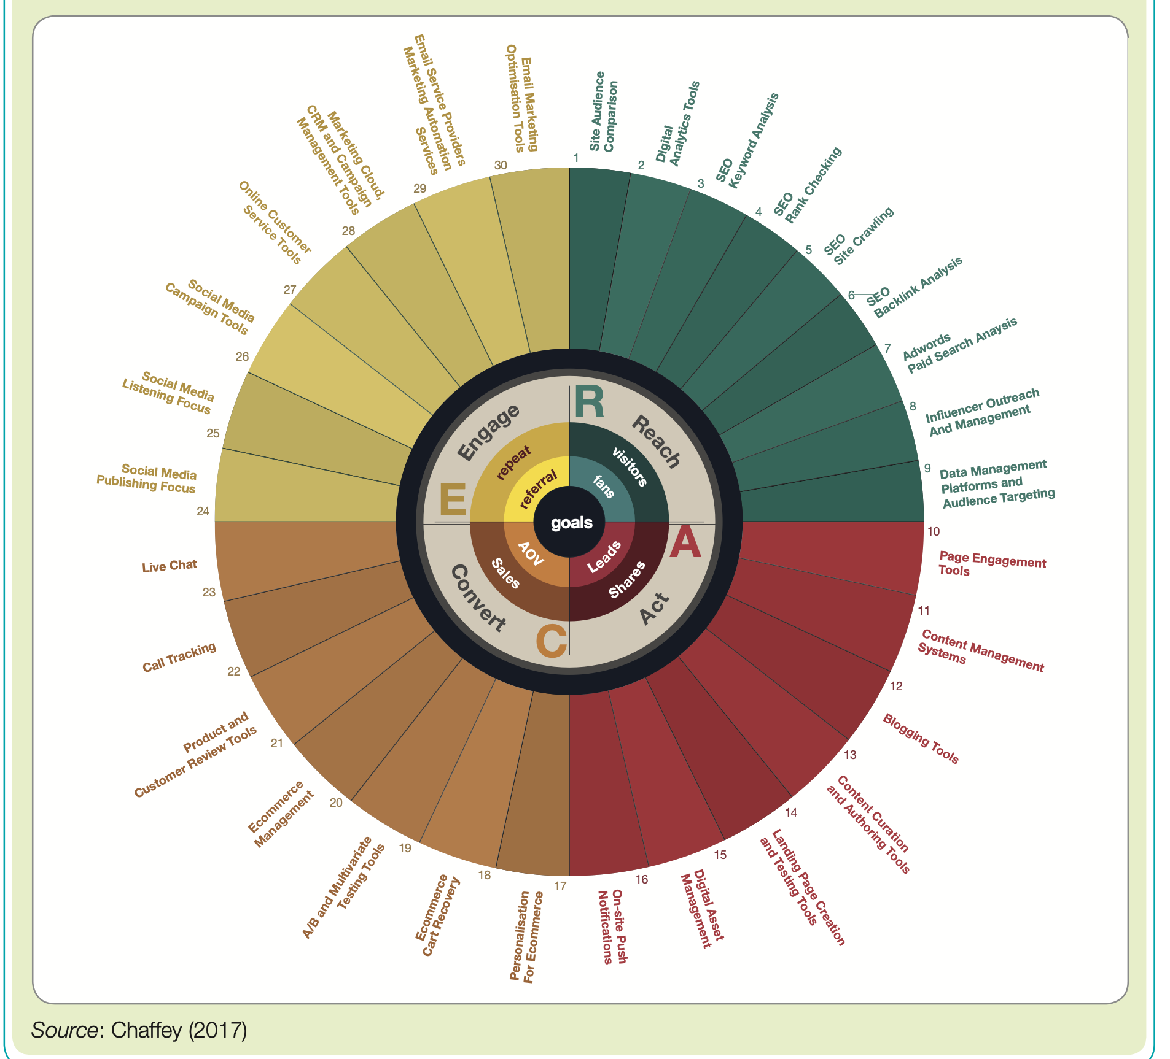
Technological forces: Selecting a martech stack

Slide 48
Technological forces: Selecting a martech stack (cont.)
Potential common problems include:
No long-term plan for martech.
Insufficient rigour when evaluating martech.
Technology solutions from different vendors aren’t integrated.
Data are inconsistent.
Customer journeys can’t be tracked across channels. New martech isn’t rolled out with sufficient updates to training and process.
Return on marketing technology isn’t reviewed.

Slide 49
Technological forces: Selecting a martech stack (cont.)
Facing a difficult decision as to:
ignore the use of the technique completely, perhaps because it is felt to be too expensive or untried, or because they simply don’t believe the benefits will outweigh the costs;
ignore the technique for now, but keep an eye on the results of other companies that are starting to use it;
evaluate the technique in a structured manner and then make a decision as to whether to adopt it according to the evaluation;
enthusiastically adopt the technique without a detailed evaluation, since the hype alone convinces the manager that it should be adopted.

Slide 50
Different stages of a Gartner hype cycle
Notes:
Figure 3.5. Different stages of a Gartner hype cycle
adoption curve was developed by technology analyst Gartner (2011) and has been applied to different technologies since 1995. A compilation of recent hype cycles for marketing technology has been created by Smart Insights (Chaffey, 2020). Gartner described a hype cycle as a graphic representation of the maturity, adoption and business application of specific technologies.
clear
​
Một ứng dụng thương mại của đường cong khuếch tán-chấp nhận được phát triển bởi nhà phân tích công nghệ Gartner (2011) và đã được áp dụng cho các công nghệ khác nhau kể từ năm 1995. Smart Insights đã tổng hợp các chu kỳ cường điệu gần đây về công nghệ marketing (Chaffey, 2020). Gartner đã mô tả một chu kỳ cường điệu như một sự thể hiện bằng đồ họa về sự trưởng thành, việc áp dụng và ứng dụng kinh doanh của các công nghệ cụ thể.
1 Kích hoạt công nghệ. Giai đoạn đầu tiên của chu kỳ quảng cáo rầm rộ là 'kích hoạt công nghệ' hoặc đột phá, ra mắt sản phẩm hoặc sự kiện khác tạo ra báo chí và sự quan tâm đáng kể.
2 Đỉnh cao của kỳ vọng tăng cao. Trong giai đoạn tiếp theo, sự công khai điên cuồng thường tạo ra
quá nhiệt tình và kỳ vọng không thực tế. Có thể có một số ứng dụng thành công
của một công nghệ, nhưng thường có nhiều thất bại hơn.
3 Máng vỡ mộng. Công nghệ bước vào 'máng vỡ mộng' vì
chúng không đáp ứng được kỳ vọng và nhanh chóng trở nên lỗi thời. Theo đó, báo chí
thường bỏ qua chủ đề và công nghệ.
4 Độ dốc của sự giác ngộ. Mặc dù báo chí có thể đã ngừng đưa tin về công nghệ,
một số doanh nghiệp tiếp tục vượt qua 'con dốc khai sáng' và thử nghiệm để hiểu rõ
hiểu được lợi ích và ứng dụng thực tế của công nghệ.
5 Bình nguyên năng suất. Một công nghệ đạt tới ‘đỉnh cao năng suất’ là những lợi ích
của nó đã được chứng minh và chấp nhận rộng rãi. Công nghệ ngày càng trở nên ổn định và phát triển ở thế hệ thứ hai và thứ ba. Chiều cao cuối cùng của mức ổn định thay đổi tùy theo công nghệ được áp dụng rộng rãi hay chỉ mang lại lợi ích cho một thị trường ngách.

Slide 51
Alternative responses to changes in technology
Notes:
So, what action should marketing and e-commerce managers take when confronted by new techniques and technologies? There is no straightforward rule of thumb, other than that a balanced approach must be taken. It would be easy to dismiss many new techniques as fads, or classify them as ‘not relevant to my market’. However, competitors are likely to be reviewing new techniques and incorporating some, so a careful review of new techniques is required. This indicates that benchmarking of ‘best of breed’ sites within a sector and in different sectors is essential as part of environmental scanning. However, by waiting for others to innovate and review the results on their website, a company has probably already lost 6 to 12 months.
Vì vậy, các nhà quản lý marketing và thương mại điện tử nên thực hiện hành động gì khi đối mặt với các kỹ thuật và công nghệ mới? Không có quy tắc chung nào đơn giản, ngoài việc phải thực hiện một cách tiếp cận cân bằng. Sẽ dễ dàng loại bỏ nhiều kỹ thuật mới như là mốt nhất thời hoặc phân loại chúng là “không phù hợp với thị trường của tôi”. Tuy nhiên, các đối thủ cạnh tranh có thể đang xem xét các kỹ thuật mới và kết hợp một số kỹ thuật mới, vì vậy cần phải xem xét cẩn thận các kỹ thuật mới. Điều này cho thấy rằng việc đánh giá các địa điểm “tốt nhất” trong một lĩnh vực và trong các lĩnh vực khác nhau là cần thiết như một phần của việc rà soát môi trường. Tuy nhiên, bằng cách chờ người khác đổi mới và xem xét kết quả trên trang web của mình, một công ty có lẽ đã mất từ 6 đến 12 tháng.

Slide 52
Legal forces
Digital marketers should be compliant with the law and adhere to ethical standards but the rate of technological innovation is rapid and consequently the law is often unclear.
In this case, marketers need to tread carefully since unethical action can result in serious damage to the reputation of a company and negative sentiment can result in a reduction in online audience or sales.
Consider:
Data protection and privacy law
Anti-spam legislation: spam, permission mkt, opt-in, opt-out, cold list, house list; cookies
Disability and discrimination law
Brand and trademark protection: domain registration; reputational damage by ads n PR; monitoring brand conversations
Intellectual property rights
Online advertising law
Notes:
Digital marketers should be compliant with the law and adhere to ethical standards but the rate of technological innovation is rapid and consequently the law is often unclear. In this case, marketers need to tread carefully since unethical action can result in serious damage to the reputation of a company and negative sentiment can result in a reduction in online audience or sales.
Luật bảo vệ dữ liệu và quyền riêng tư
Luật chống thư rác
Luật khuyết tật và phân biệt đối xử
Bảo hộ thương hiệu và nhãn hiệu
Quyền sở hữu trí tuệ
Luật quảng cáo trực tuyến
Persistent cookies. These stay on a user’s computer between multiple sessions and are most valuable for marketers to identify repeat visits to sites.
• Temporary or session cookies (single session). Useful for tracking within pages of a session such as on an e-commerce site.
• First-party cookies. Served by the site visitors are accessing. These can be persistent or session cookies.
• Third-party cookies. Served by another site to the one being viewed, typically for publishers where an ad network will track remotely or where the web analytics soft- ware places a cookie. These are typically persistent cookies.
Spam
Unsolicited email (usually bulk mailed and untargeted).
Permission marketing
Customers agree (opt-in) to be involved in an organisation’s marketing activities, usually as a result of an incentive.
Opt-in
A customer proactively agrees to receive further information.
Opt-out
A customer declines the offer to receive further information.
Cold list
Data about individuals that are rented or sold by a third party.
House list
Data about existing customers used to market products to encourage future purchase.

Slide 53
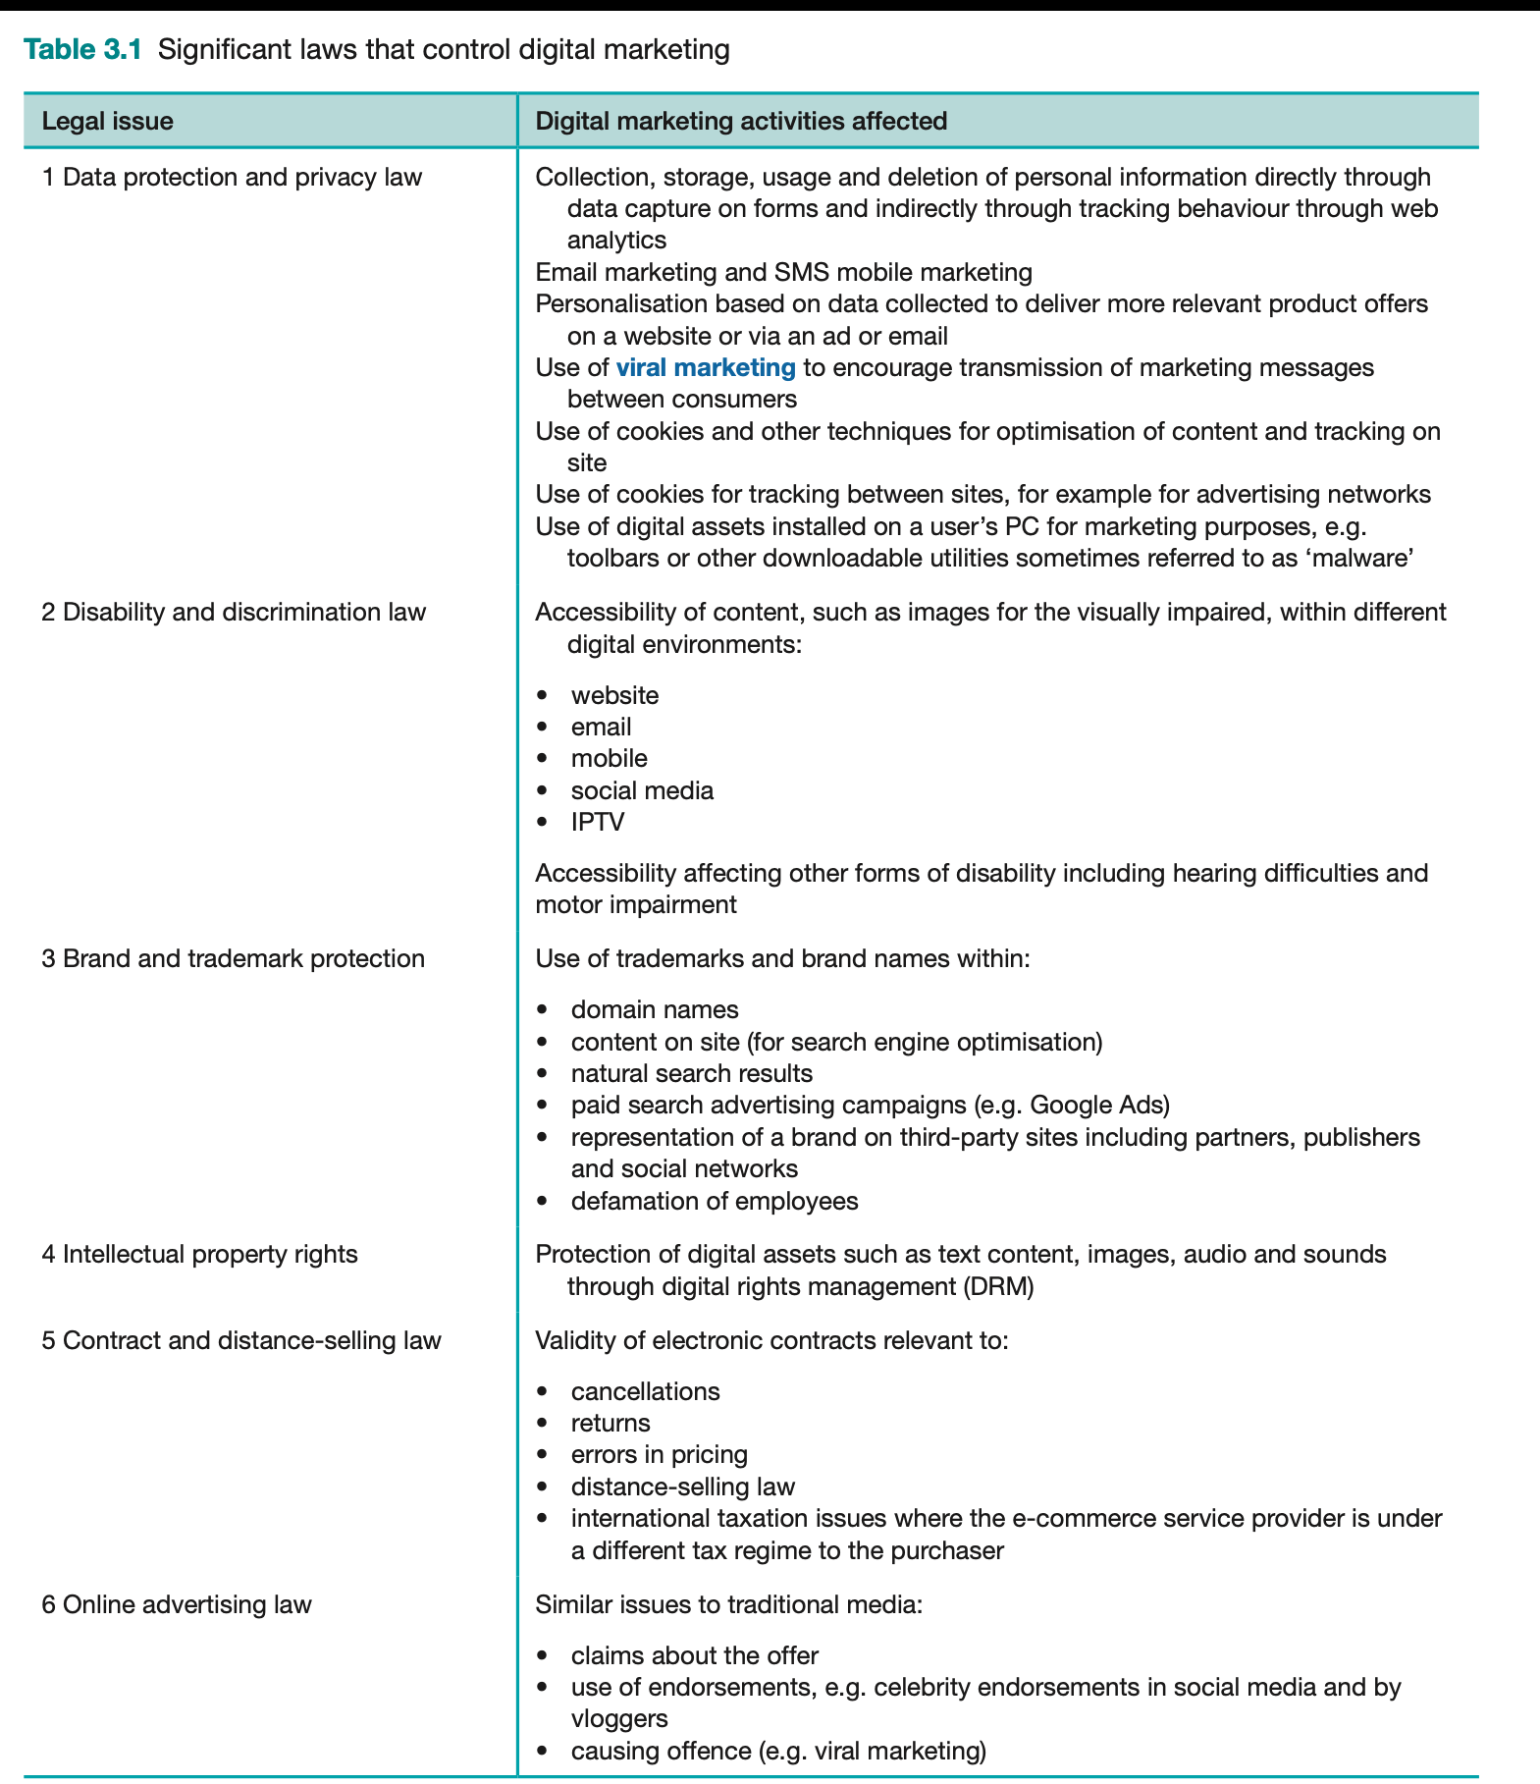
Legal forces
Notes:
Digital marketers should be compliant with the law and adhere to ethical standards but the rate of technological innovation is rapid and consequently the law is often unclear. In this case, marketers need to tread carefully since unethical action can result in serious damage to the reputation of a company and negative sentiment can result in a reduction in online audience or sales.
Luật bảo vệ dữ liệu và quyền riêng tư
Luật chống thư rác
Luật khuyết tật và phân biệt đối xử
Bảo hộ thương hiệu và nhãn hiệu
Quyền sở hữu trí tuệ
Luật quảng cáo trực tuyến
Persistent cookies. These stay on a user’s computer between multiple sessions and are most valuable for marketers to identify repeat visits to sites.
• Temporary or session cookies (single session). Useful for tracking within pages of a session such as on an e-commerce site.
• First-party cookies. Served by the site visitors are accessing. These can be persistent or session cookies.
• Third-party cookies. Served by another site to the one being viewed, typically for publishers where an ad network will track remotely or where the web analytics soft- ware places a cookie. These are typically persistent cookies.
Spam
Unsolicited email (usually bulk mailed and untargeted).
Permission marketing
Customers agree (opt-in) to be involved in an organisation’s marketing activities, usually as a result of an incentive.
Opt-in
A customer proactively agrees to receive further information.
Opt-out
A customer declines the offer to receive further information.
Cold list
Data about individuals that are rented or sold by a third party.
House list
Data about existing customers used to market products to encourage future purchase.

Slide 54
Legal forces (cont.)
The main information types used by the digital marketer that are governed by ethics and legislation are:
1 Contact information. This is the name, postal address, email address and, for B2B com- panies, website address.
2 Profile information. This is information about a customer’s characteristics that can be used for segmentation. It includes age, sex and social group for consumers, and company characteristics and individual role for business customers (see Chapter 6).
3 Platform usage information. Through web analytics systems it is possible to collect infor- mation on type of computer, browser and screen resolution used by site users (see Chapter 7).
4 Behavioural information (on a single site). This is purchase history and the whole of the buying process. Web analytics (Chapter 10) can be used to assess the web and email content accessed by individuals.
5 Behavioural information (across multiple sites). This can potentially show how a user accesses multiple sites and responds to adverts across sites. Typically these data are col- lected and used through an anonymous profile based on cookie or IP addresses, which are not related to an individual.
Notes:
The main information types used by the digital marketer that are governed by ethics and legislation are:
1 Contact information. This is the name, postal address, email address and, for B2B com- panies, website address.
2 Profile information. This is information about a customer’s characteristics that can be used for segmentation. It includes age, sex and social group for consumers, and company characteristics and individual role for business customers (see Chapter 6).
3 Platform usage information. Through web analytics systems it is possible to collect infor- mation on type of computer, browser and screen resolution used by site users (see Chapter 7).
4 Behavioural information (on a single site). This is purchase history and the whole of the buying process. Web analytics (Chapter 10) can be used to assess the web and email content accessed by individuals.
5 Behavioural information (across multiple sites). This can potentially show how a user accesses multiple sites and responds to adverts across sites. Typically these data are col- lected and used through an anonymous profile based on cookie or IP addresses, which are not related to an individual.

Slide 55
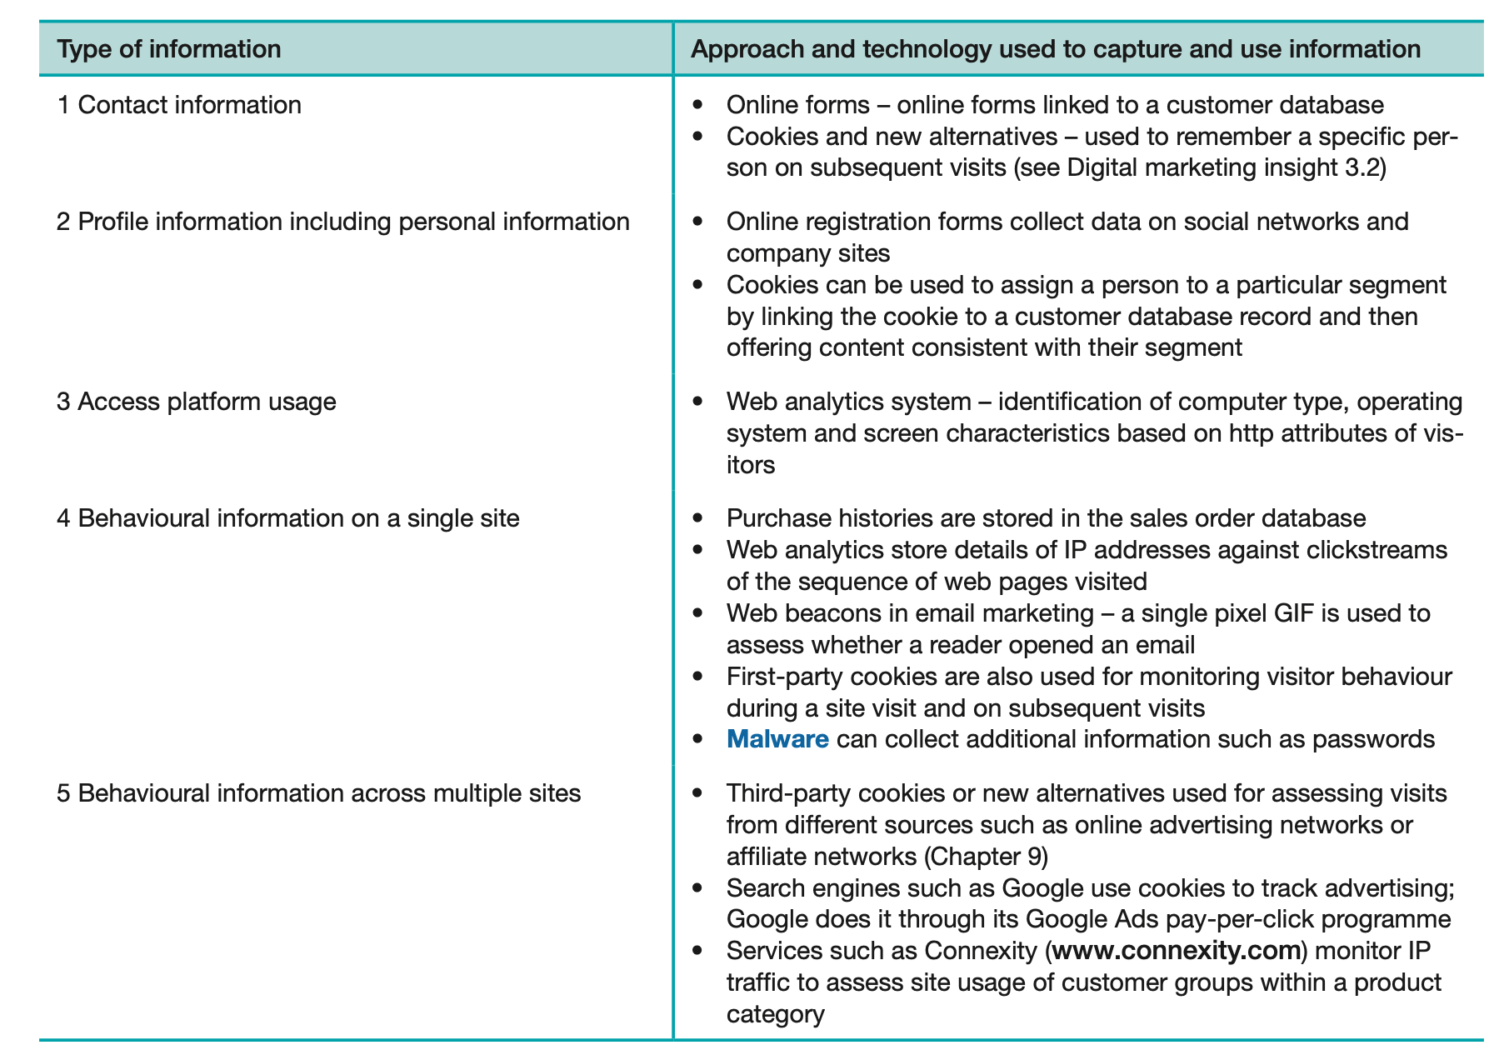
Legal forces: Types of information collected online and the related technologies

Slide 56
Legal forces (cont.)
Contract and distance-selling law
Distance-selling law
Legal requirements for providing information about the contractual agreement entered into between a merchant and customer for providing goods and services, including company information, pricing, additional costs and returns.
Online advertising law
Native advertising
Online content that is integrated with publisher editorial content to promote or enhance a brand, such as a publisher article or social media update. Such content should be disclosed as advertising by law in many countries, and for this reason publishers refer to it as branded content.
Notes:
Contract and distance-selling law
Distance-selling law
Legal requirements for providing information about the contractual agreement entered into between a merchant and customer for providing goods and services, including company information, pricing, additional costs and returns.
Online advertising law
Native advertising
Online content that is integrated with publisher editorial content to promote or enhance a brand, such as a publisher article or social media update. Such content should be disclosed as advertising by law in many countries, and for this reason publishers refer to it as branded content.

Slide 57
Political trends
The political environment is shaped by the interplay of government agencies, public opinion and consumer pressure groups, and industry-backed organisations.
Political action and control:
Internet governance: Control of the operation and use of the internet.
Net or network neutrality: is the principle of provision of equal access to different internet services by telecommunications service providers.
Taxation: How to change tax laws to reflect globalisation of trade facilitated by the internet.
Tax Jurisdiction: determines which country gets the tax income from a transaction
Notes:
Political forces. National governments and transnational organisations have a role in determining the future adoption and control of telecommunications technology and the rules by which it is governed.
The political environment is shaped by the interplay of government agencies, public opinion and consumer pressure groups, and industry-backed organisations.
​Thuế : The fear is that the internet may cause significant reductions in tax revenues to national or local governments if existing laws do not cover changes in purchasing patterns.
Thẩm quyền về thuế: Tax jurisdiction determines which country gets the tax income from a transaction. Under the current system of international tax treaties, the right to tax is divided between the coun- try where the enterprise that receives the income is resident (‘residence’ country) and that from which the enterprise derives that income (‘source’ country). Laws on taxation are rapidly evolving and vary dramatically between countries.
Cơ quan có thẩm quyền về thuế xác định quốc gia nào nhận được thu nhập từ thuế từ một giao dịch. Theo hệ thống các hiệp định thuế quốc tế hiện hành, quyền đánh thuế được phân chia giữa quốc gia nơi doanh nghiệp nhận thu nhập là cư dân (quốc gia 'cư trú') và quốc gia nơi doanh nghiệp có thu nhập đó (quốc gia 'nguồn') . Luật thuế đang phát triển nhanh chóng và khác nhau đáng kể giữa các quốc gia.

Slide 58
Social forces
Social forces. Cultural diversity among digital communities influences use of the digital development, devices and platforms and the services that businesses provide online.
Social exclusion
Part of society is excluded from the facilities available to the remainder.
Digital minimalism and digital addiction
Notes:
Social forces. Cultural diversity among digital communities influences use of the digital development, devices and platforms and the services that businesses provide online.
Social exclusion
Part of society is excluded from the facilities available to the remainder.
Digital minimalism and digital addiction
Chủ nghĩa tối giản kỹ thuật số và chứng nghiện kỹ thuật số

Slide 59
Economics forces
These cause variation in economic conditions and affect trading opportunities, influence consumer spending and business performance, and have significant implications for digital marketing planning.
Economic growths
Market growth and employment
Interest and exchange rates
Globalization
Economic disruption
Notes:
Economic forces. These cause variation in economic conditions and affect trading opportunities, influence consumer spending and business performance, and have significant implications for digital marketing planning.
Economic growths
Market growth and employment
Interest and exchange rates
Globalization
Economic disruption

Slide 60
Chapter references
Chaffey D. & Ellis-Chadwick F. (2022). Digital marketing - Strategy, Implementation and Practice (8th edition). Pearson. UK. Chapter 2, 3

Slide 61


